Slide 1
SMART STREET LIGHTING SYSTEM
UEE1718 – PROJECT WORK – PHASE 2
BATCH: A15
GROUP MEMBERS:
Akash Kannan 183001008
Sujit Aluru 183001009
Anand Kumar 183001011
Arjun S 183001013
GUIDE:
Dr. R. Rengaraj

Slide 2
DETAILS OF THE PROJECT
TYPE: In-house
OUTCOME: Prototype
DOMAIN: Internet of Things

Slide 3
OBJECTIVE
The objective of this project is
To bring about energy conservation through smart solar powered street lighting.
To optimize lighting by detecting speed of vehicles.
To implement cloud solution ( connectivity).
To collect and store data obtained from sensors in cloud based storage system.
To analyze the data stored in the cloud.
3

Slide 4
CONTROL FLOW

Slide 5
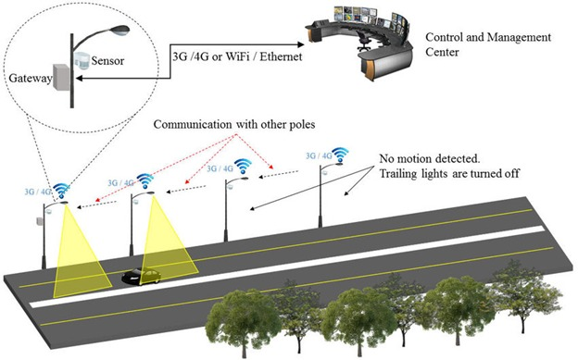
VISUAL MODEL

Slide 6
CLOUD IMPLEMENTATION
Arduino micro-controller sends serial data to the ESP32 module
This module communicates with the server (Heroku) using GSM module.
The server pushes the data into SQL database (dynamo DB).
To view the data and control the Arduino, we can develop android or computer application.

Slide 7
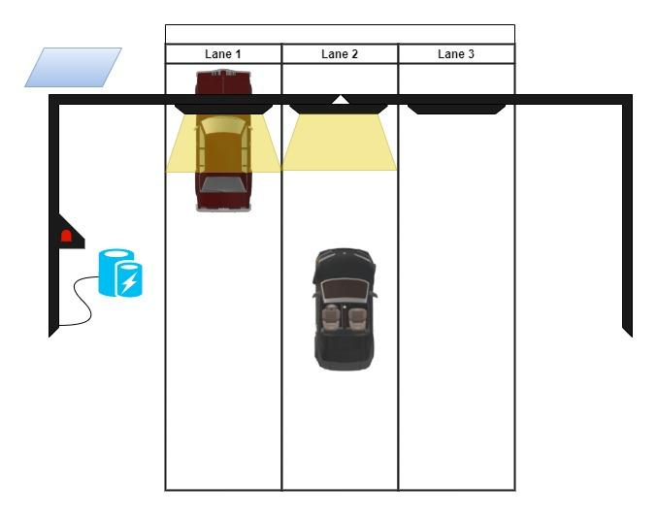
HORIZONTAL LIGHTING

Slide 8
ADVANTAGES
Economical
Automation
Eco-friendly
Public safety
Low maintenance

Slide 9
PROJECT SCHEDULE
STAGE 1 – [MAR] Conceptualizing
STAGE 2 – [APR] Formalising idea and resources
STAGE 3 – [MAY] Prototype development
STAGE 4 – [JUNE] Final Model

Slide 10
REFERENCES
“Internet Of Things Based Intelligent Street Lighting System for Smart City”, 2016, published on ResearchGate by Prakash Tambre, Prabhu Venkatachalam | https://www.researchgate.net/publication/323280626
“Smart Street Light using Hybrid System”, 2021, published on IEEE by A. Elakya, S. S. Sindhoori, S. Selvendran, P. Shanmugapriya and E. Sneha
https://ieeexplore.ieee.org/document/9441744
"GSM-GPRS Based Smart Street Light", Robotics Electrical and Signal Processing Techniques (ICREST) 2021 2nd International Conference on, pp. 67-71, 2021.by Imran Kabir, Shihab Uddin Ahamad, Mohammad Naim Uddin, Shah Mohazzem Hossain, Faija Farjana, Partha Protim Datta, Md. Raduanul Alam Riad, Mohammed Hossam-E-Haide.

Slide 11
REFERENCES
"Smart Street lighting System," 2018 3rd International Conference on Communication and Electronics Systems (ICCES), 2018, pp. 630-633, doi: 10.1109/CESYS.2018.8723949.by S.C. Suseendran, K. B. Nanda, J. Andrew and M. S. Bennet Praba.
"Smart Street Light Management System with Automatic Brightness Adjustment Using Bolt IoT Platform", IOT Electronics and Mechatronics Conference (IEMTRONICS) 2021 IEEE International, pp. 1-6, 2021,by Sk Mahammad Sorif, Dipanjan Saha, Pallav Dutta.
"A New High Gain DC-DC Boost Converter with Continuous Input and Output Currents," 2019 10th International Power Electronics, Drive Systems and Technologies Conference (PEDSTC), 2019, pp. 224-229, doi: 10.1109/PEDSTC.2019.8697693, by M. Eydi, S. H. Hosseini and R. Ghazi.

Slide 12
THANK YOU!

